Slide 1
Microsoft 365 & Power Platform Development – Bi-weekly call
Your host in this call: David Warner (Microsoft)
July 21st, 2022

Slide 2




v
Agenda
Latest on PnP Framework and Core SDK extension
Latest on PnP PowerShell
Latest on yo Teams
Latest on Microsoft Graph Toolkit
Independent Publisher Connectors
Latest on script samples
Latest Microsoft Teams samples
Latest on Power Platform samples
Picture time with the Together Mode!
Ankit Rastogi - Document automation with Syntex Content Assembly
Eoin O'Brien - Building an app for Microsoft Teams which creates conversational tabs and conversations based on external events
Chris Kent - List Formatting – Warrior horses are here again!

Slide 3
Opportunities to Participate in the community
Demo solution or technical pattern
Contribute on GitHub
Provide feedback
Great opportunity to get visibility for you or your company. Demo sample or explain how you extend or customize SharePoint Online with live demo in your projects. Reach out to team for volunteering.
Request a demo spot on the call
https://aka.ms/m365pnp/request/demo

Slide 4
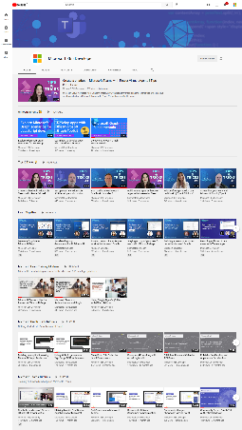
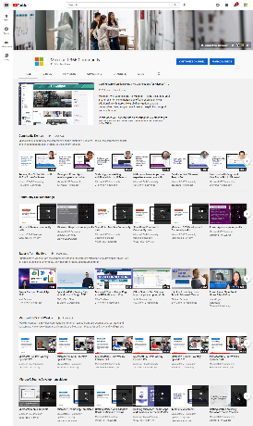
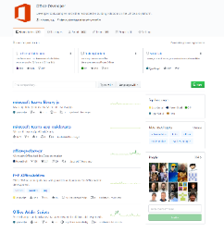
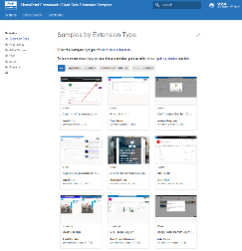
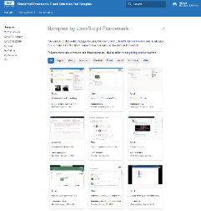
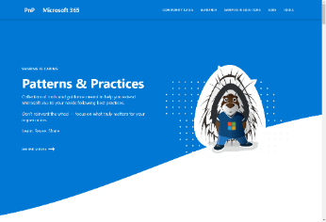
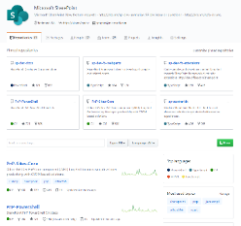
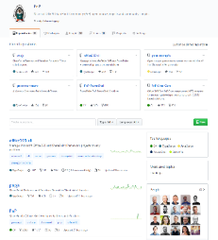
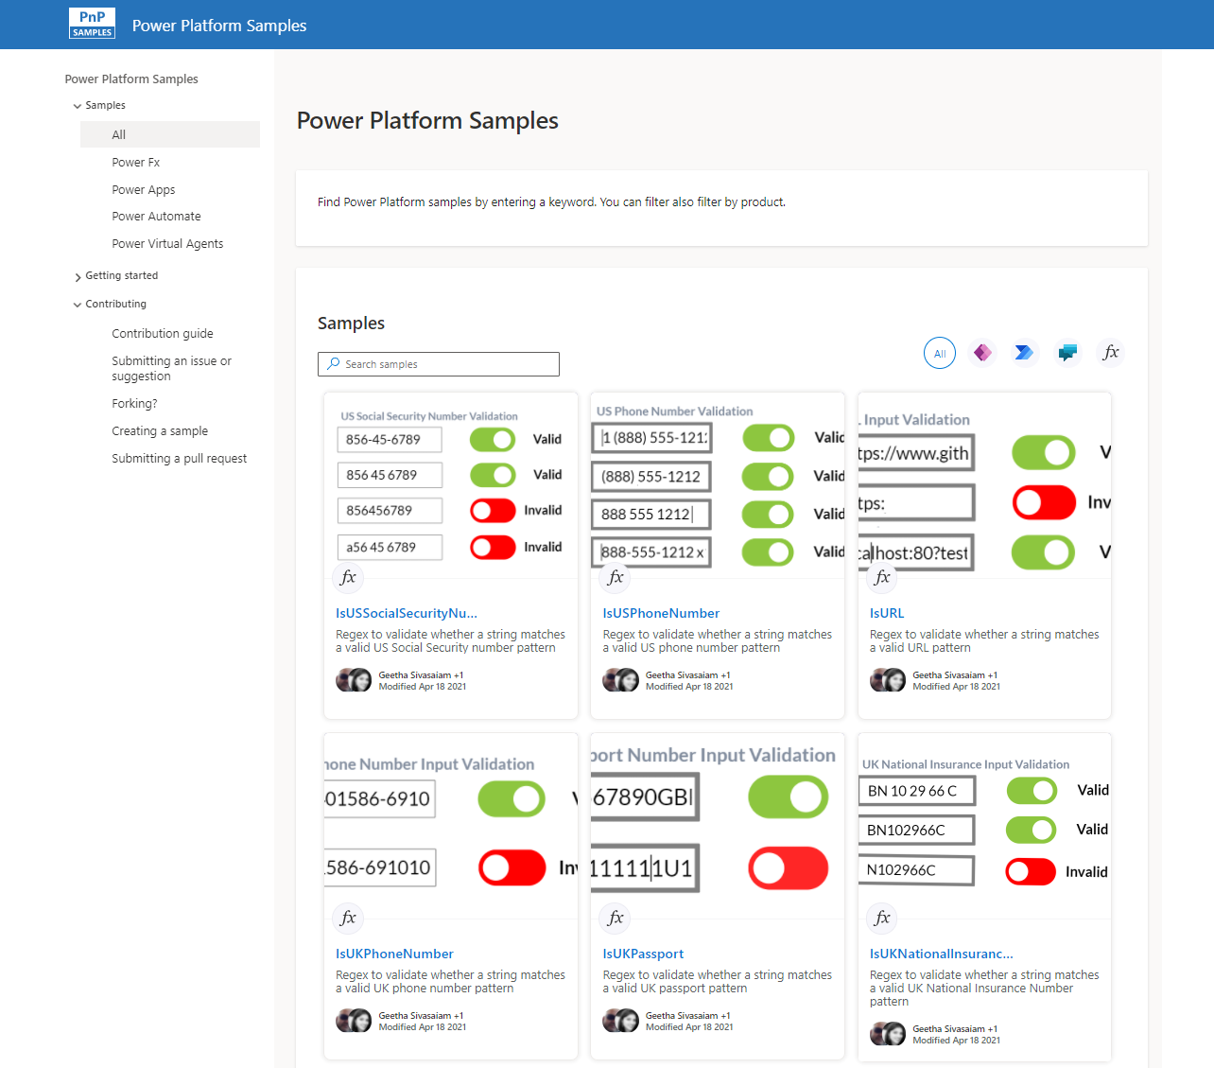
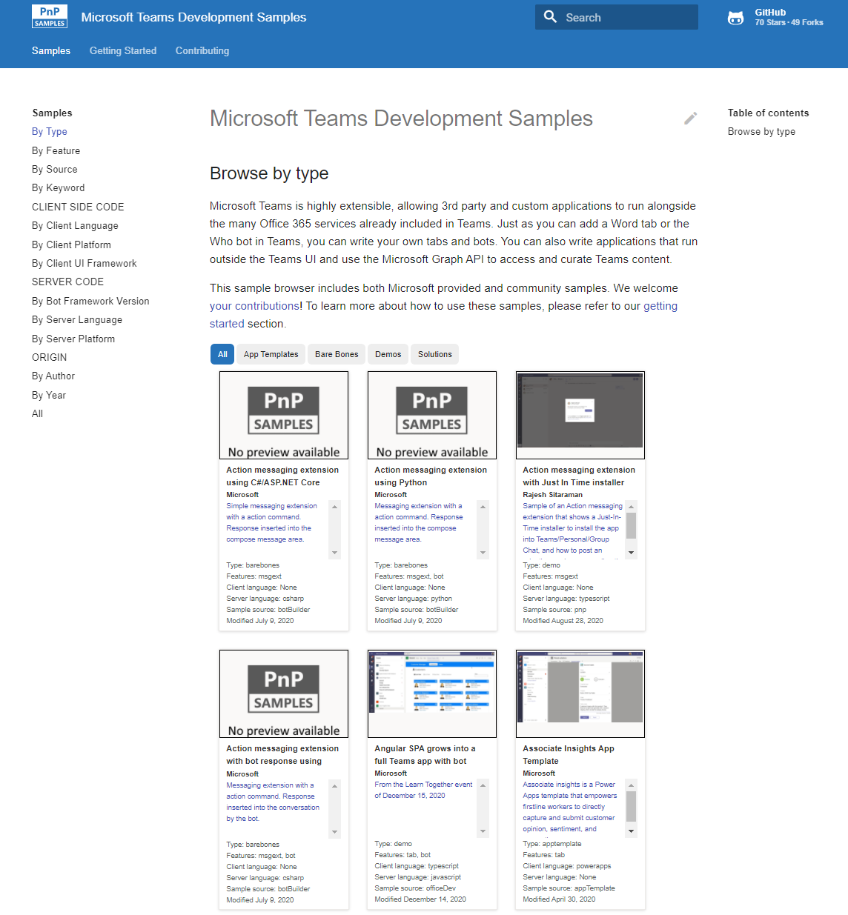
Microsoft 365 developer videos
Microsoft 365 community videos
Open-source
Sample galleries
Open-source initiatives and samples
github.com/sharepoint
github.com/pnp
github.com/officedev
github.com/microsoftgraph
aka.ms/m365/samples
aka.ms/teams-samples
aka.ms/spfx-webparts
aka.ms/powerplatform-samples
aka.ms/spfx-extensions
aka.ms/list-formatting
aka.ms/m365/community
aka.ms/m365devyoutube
aka.ms/m365pnp/videos
@Microsoft365Dev | @m365pnp

Slide 5
Microsoft 365 developer community calls
Microsoft 365 platform (weekly) https://aka.ms/m365-dev-call
(Notice. This call is on a summer break between July 1st and 31st of August 2022)
Adaptive Cards https://aka.ms/adaptivecardscommunitycall
Microsoft identity platform https://aka.ms/IDDevCommunityCalendar
Office Add-ins https://aka.ms/officeaddinscommunitycall
Power Platform https://aka.ms/PowerPlatformMonthlyCall
Microsoft 365 & Power Platform Development (bi-weekly) https://aka.ms/m365-dev-sig
Viva Connections & SharePoint Framework (bi-weekly) https://aka.ms/spdev-spfx-call
Download recurrent invites from
https://aka.ms/m365/calls
Notes:
m365-dev-sig

Slide 6

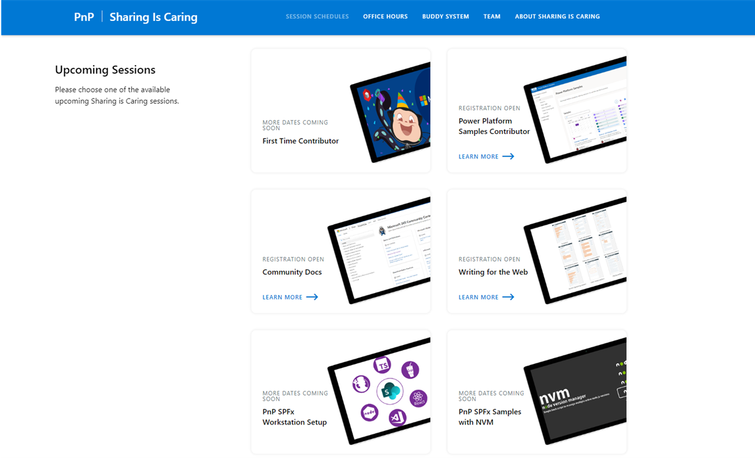
GUIDANCE
Learn how to get started in the open-source PnP community!
Upcoming Sessions:
First-time contributor
Power Platform Samples Contributor
Community Content Docs
SPFx Developer Workstation Setup
Using PnP SPFx samples w/ NVM
More than code with VS Code
First-time presenter
M365 Maturity Model Practitioners
Writing for the Web
Power Platform Samples Contributor
August Dates!!!
https://aka.ms/sharing-is-caring
Notes:
25 Total attendees, 16 attendees who attended both First-Time Contributors and Community Docs sessions.

Slide 7





COMMUNITY
PnP Recognition Program
Showcasing your contributions
Powered by Credly
More achievement levels coming soon
https://aka.ms/m365pnp-recognition
Notes:
25 Total attendees, 16 attendees who attended both First-Time Contributors and Community Docs sessions.

Slide 8
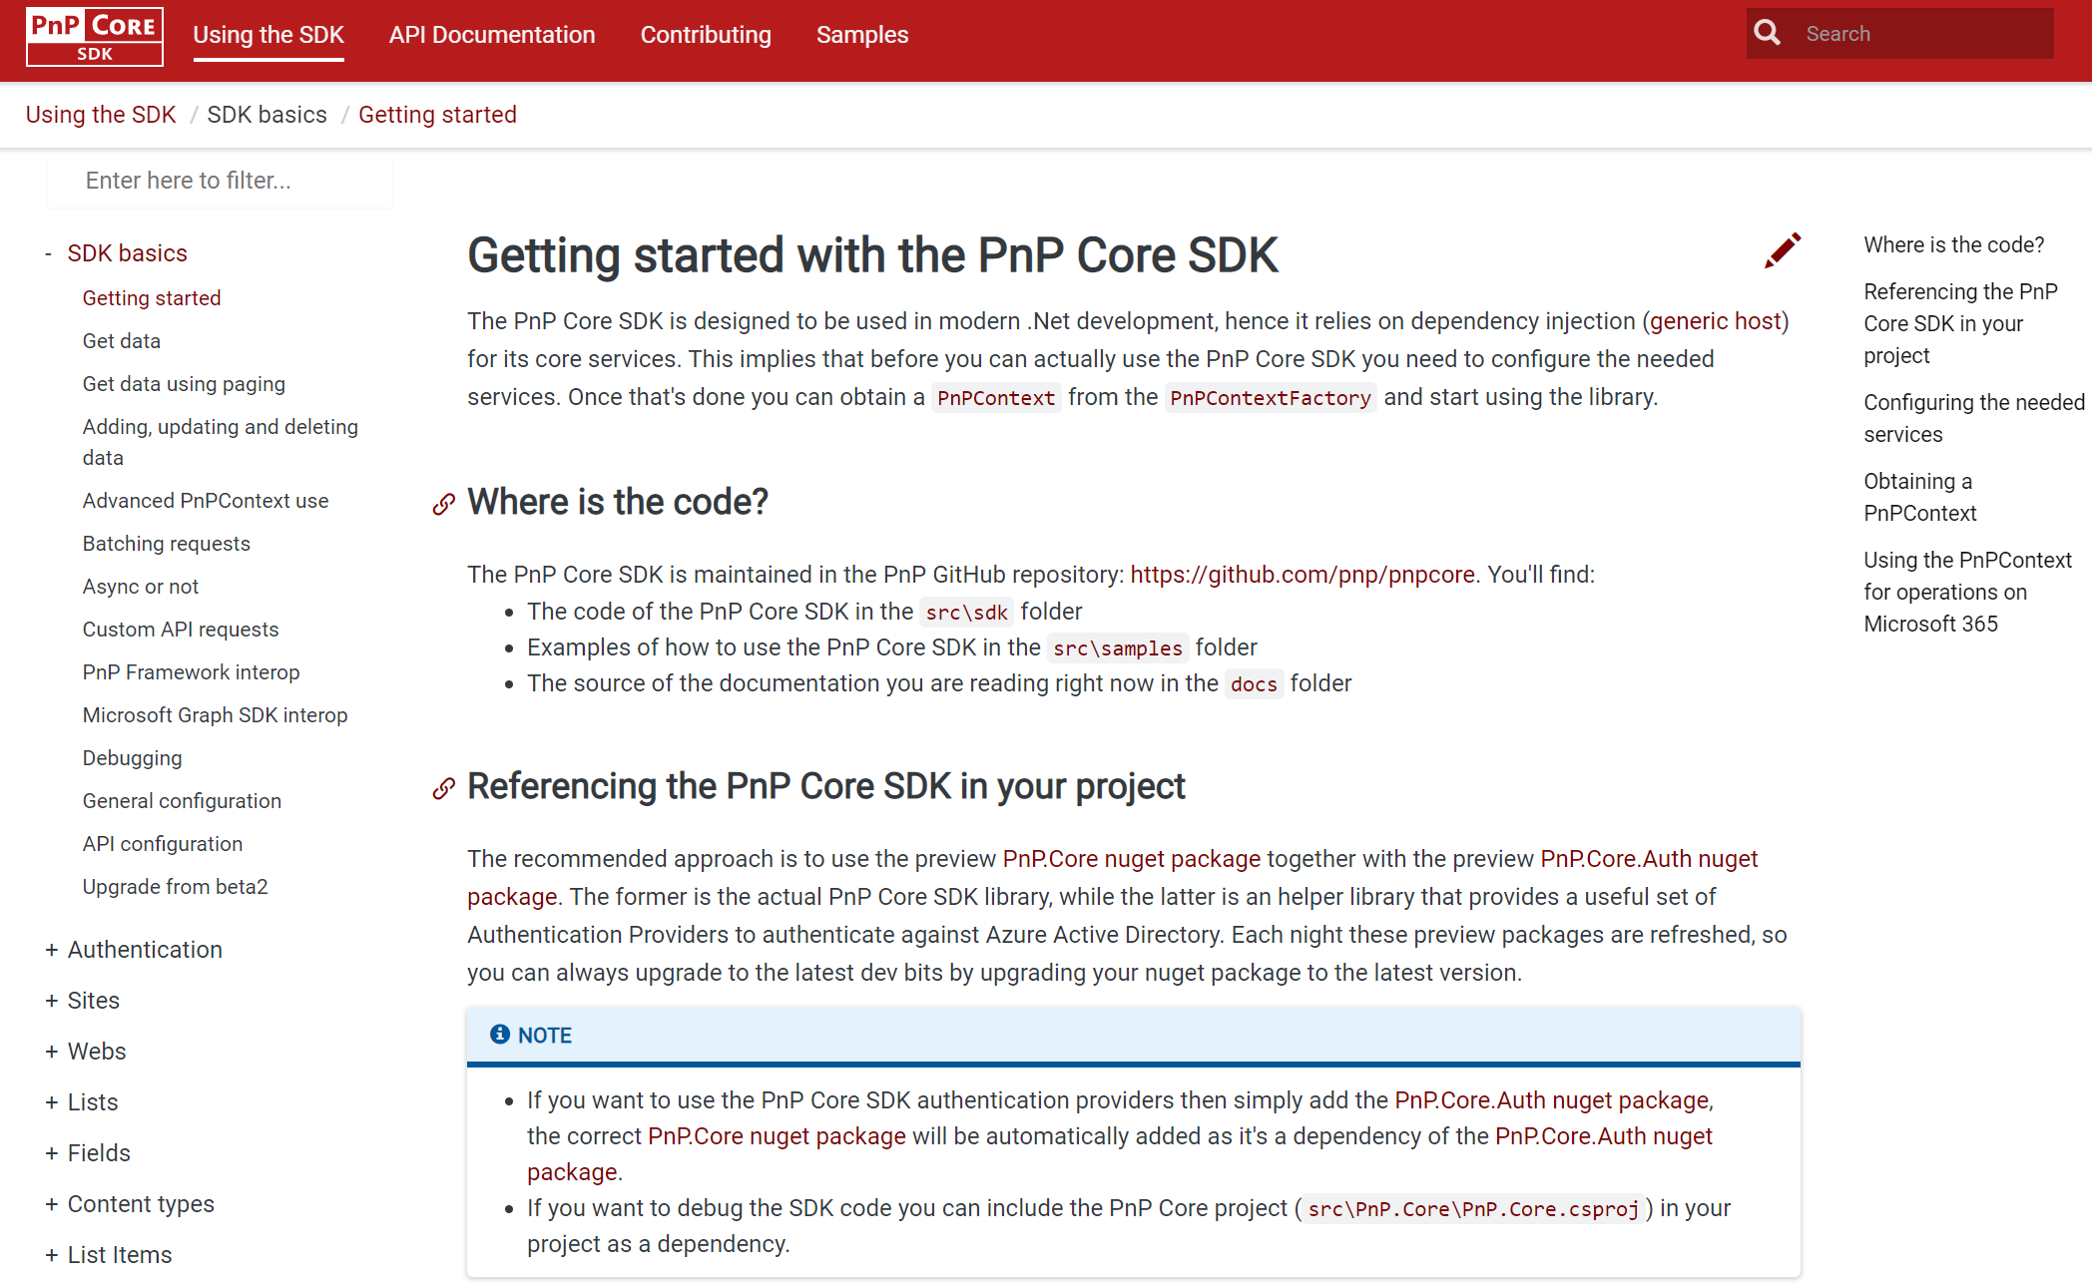
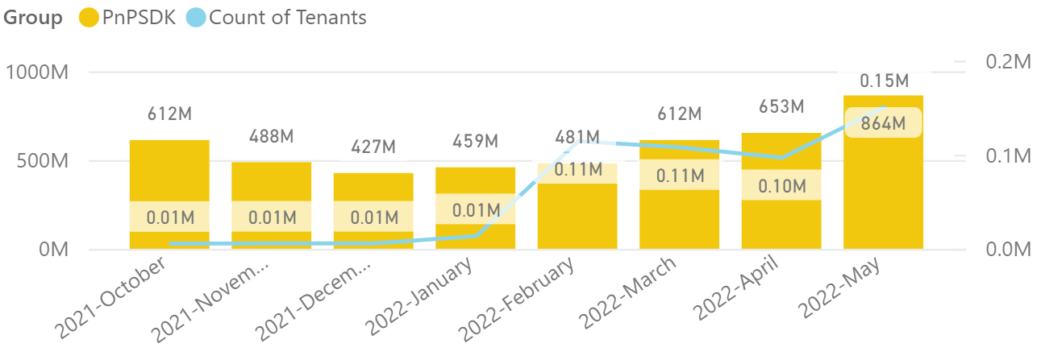
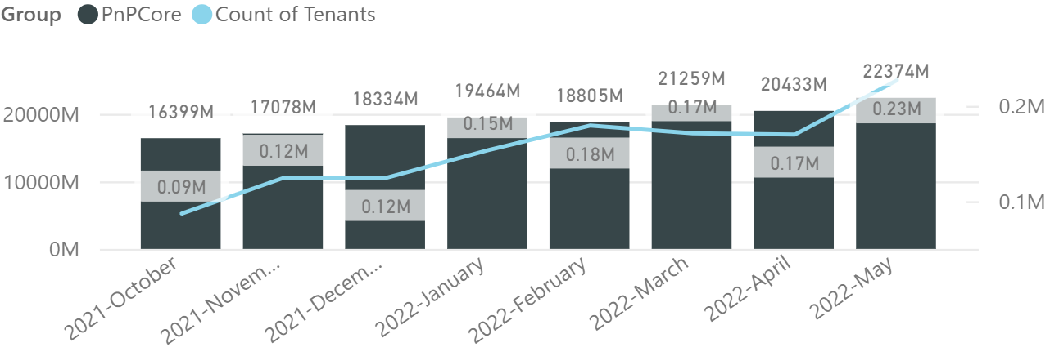

PnP .NET libraries
PnP Framework
PnP Core SDK
>220.000
tenants!
637,000 downloads!
Prepping 1.11.0 (after summer break):
Merge pending PRs
Support for new SFPx Form Customizers for lists and libraries
General fixes and improvements: 👍 Gautam Sheth and Koen Zomers
841,000 downloads!
Prepping for 1.8.0 (after summer break):
Support for using RefinementFilters: Llewellyn Roos 👍💪🚀
Getusereffectivepermissions support: Mathijs Verbeeck 👍💪🚀
Fixes and improvements: Bert Jansen 👍
Prepping for 1.8.0 (after summer break)
Working on it
What key scenarios are still missing?
https://github.com/pnp/pnpcore/blob/dev/src/sdk/CHANGELOG.md
Roadmap
nuget.org/profiles/pnp
nuget.org/profiles/pnp
aka.ms/pnp/framework
aka.ms/pnp/coresdk

Slide 9

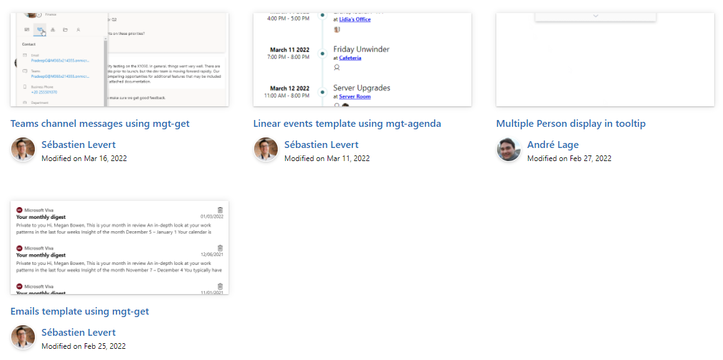

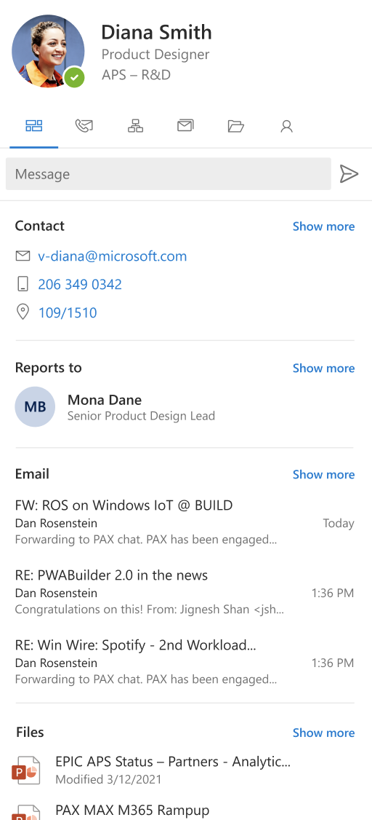
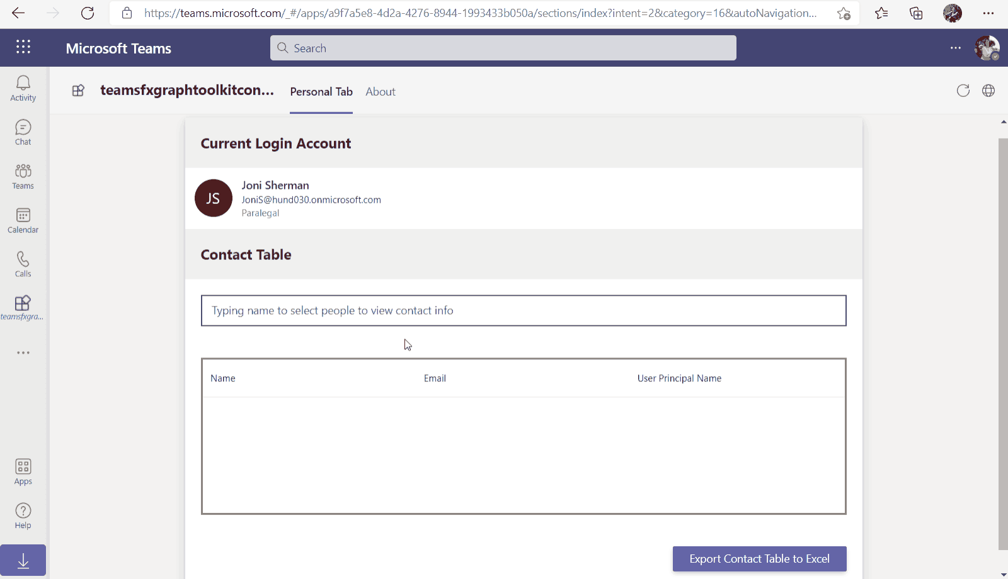
Microsoft Graph Toolkit
👀 More information: aka.ms/mgt
What’s new 🎉
V2.6.0 is our latest release! Update your packages! https://aka.ms/mgt/v2.6.0
Accessibility updates
Support for SPFx 1.15
Documentation on TeamsFx
Updates mgt-people-picker
Thanks @wuxiaojun514 for your contributions 🎉
The MGT samples repository is live! Keep your contributions coming! https://aka.ms/mgt/samples
What's next? 💻
Aligning all Toolkit components to Fluent UI Web Components
More generic components and theming capabilities
We need your help ❤️
🐞 Help us fix bugs
🆕 Help us build/improve features
help-wanted & good-first-issue -> https://aka.ms/mgt/issues

Slide 10

Independent Publisher Connectors
What’s new
51 Awesome Independent Publishers!
153 Independent Publisher connectors!
New connector submissions:
Harold Anderson- SOS Inventory
Troy Taylor- ConvertKit
Troy Taylor- Every
Troy Taylor- File.io
Troy Tayor- RescueGroups.org
Troy Tayor- SchoolDigger
Troy Taylor- SignUpGenius
Troy Taylor- Zenler
We need your help
Become an Independent Publisher by building one of these connectors: Top Connector Asks · microsoft/PowerPlatformConnectors Wiki (github.com)
OR
By adding more functionality to one of the existing Independent Publisher connectors on the Power Platform

Slide 11
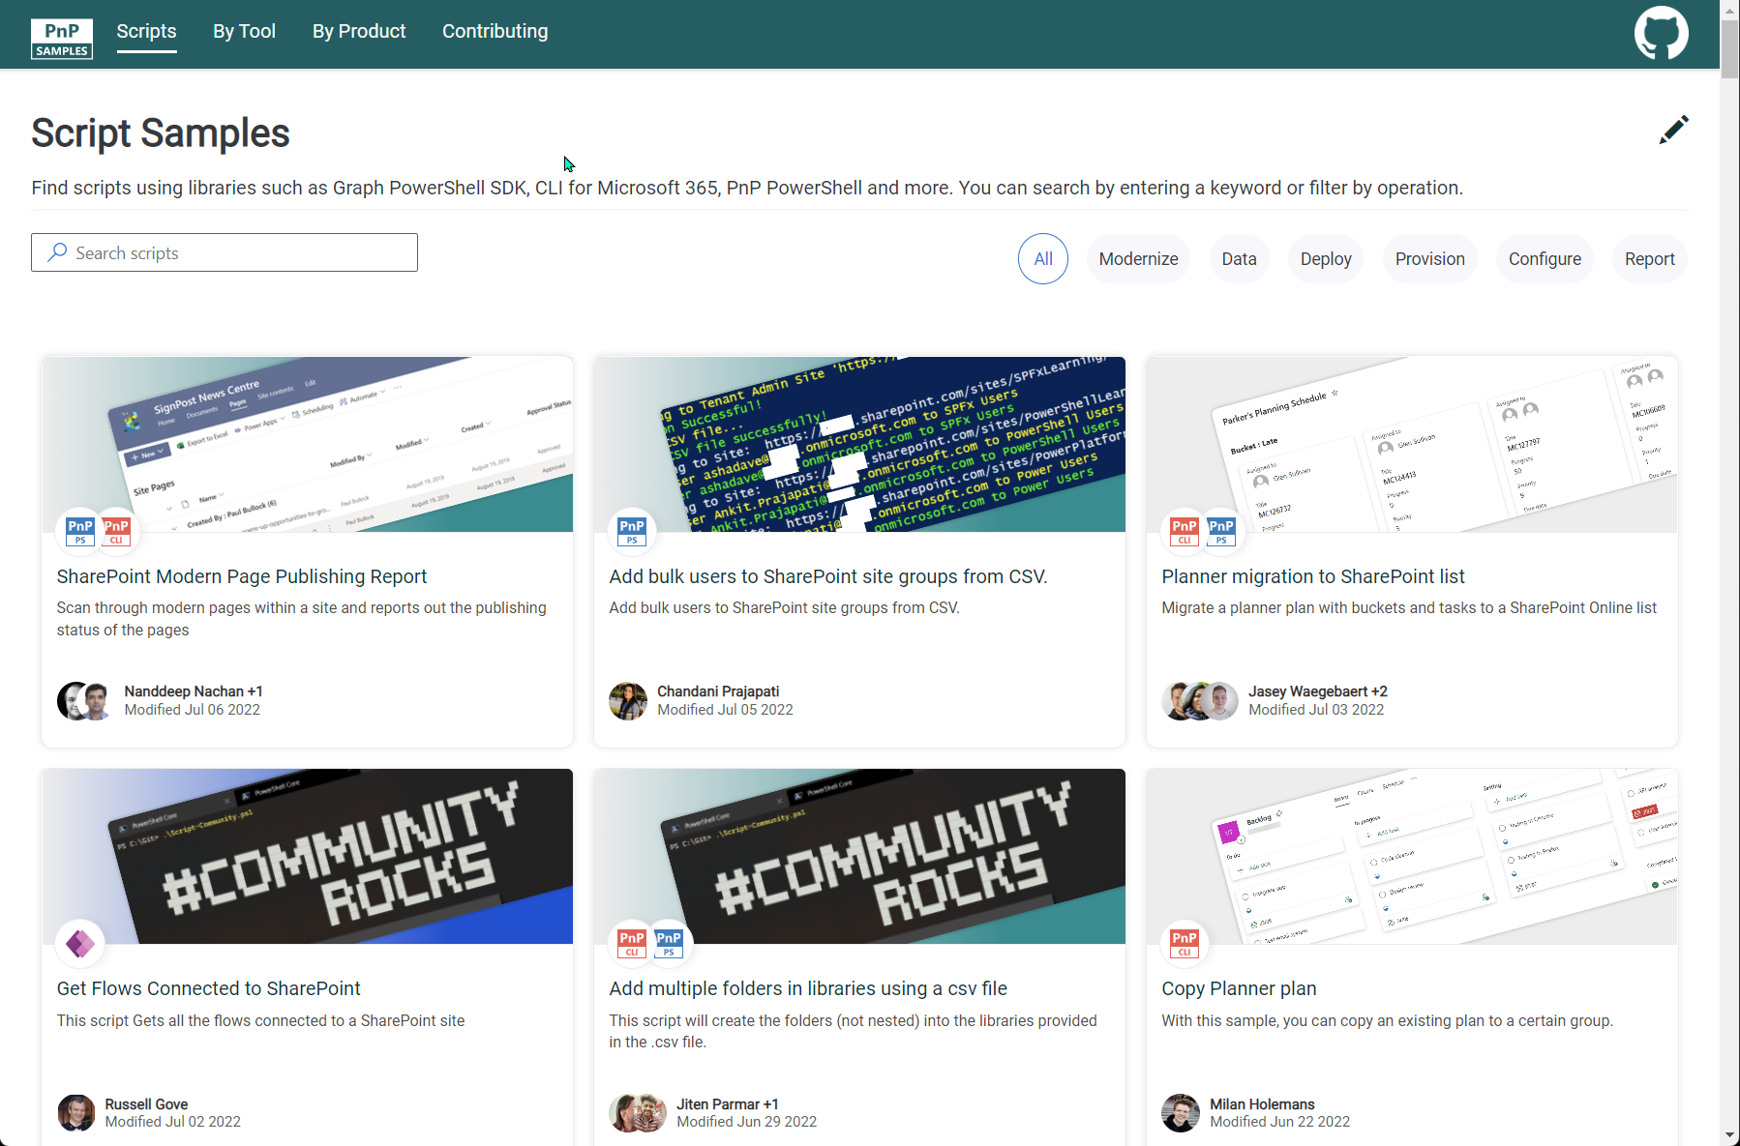
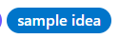


SCRIPT SAMPLES
One centralized location for all scripts for helping your day-to-day life. Contribution's welcome!
Site now has 158 scenarios and 242 scripts, using Microsoft Graph, CLI for Microsoft 365, PnP PowerShell, SPO Management Shell tooling and more…😁 AND samples integrated into "Unified" Solution Gallery
Awesome Samples Include :
New scenario using PnP PowerShell
Update web part properties on modern pages by Ramin Ahmadi
Export SharePoint Term Store terms to CSV by Ramin Ahmadi
New scenarios using CLI for Microsoft 365 Scripts
List external users across all sites and in what site groups by Martin Lingstuyl
Updated Scenarios with CLI for Microsoft 365 Scripts
List all external users in all site collections by Martin Lingstuyl
Updated Scenarios with PnP PowerShell Scripts
Copy Planner plan by Reshmee Auckloo
We have good firsin the GitHub Repo with sample ideas of scripts that you could contribute to ☺ https://github.com/pnp/script-samples
Thank you for your samples and contributions – your awesome and happy holidays! 👏
aka.ms/script-samples
good first issue

Slide 12

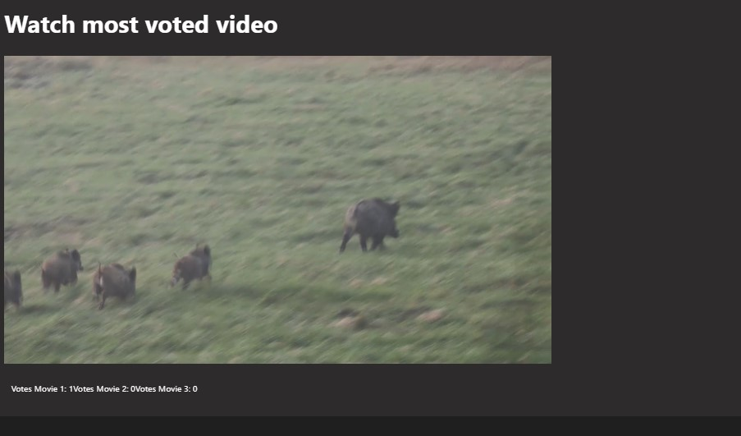
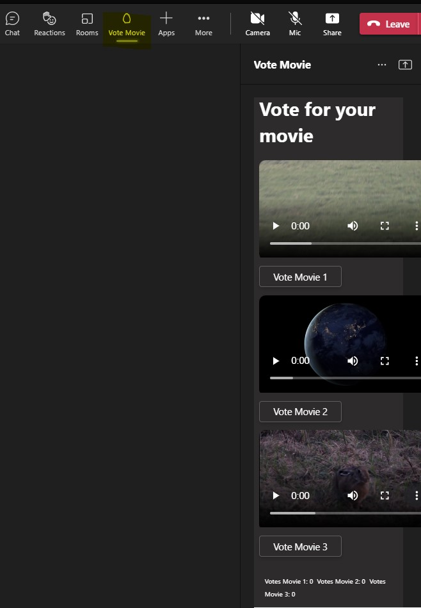
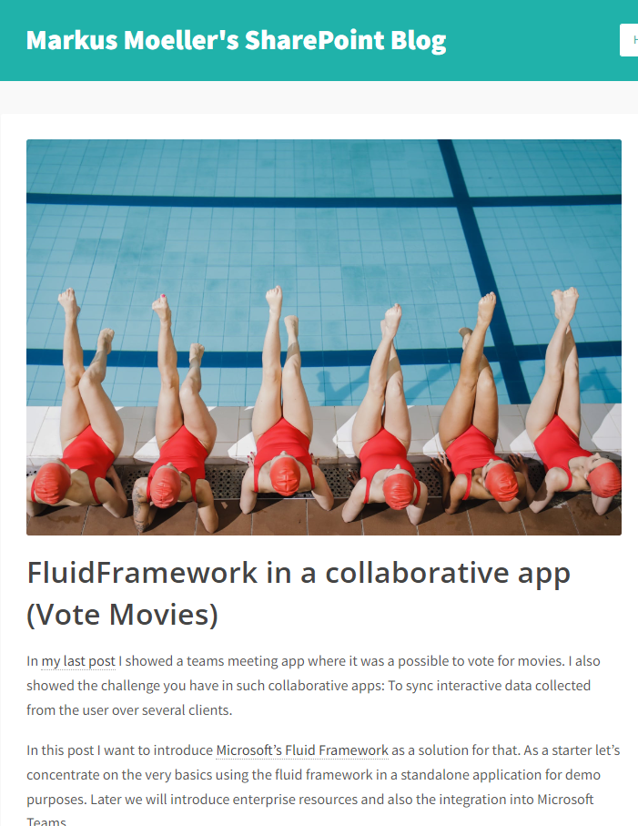








Microsoft Teams Samples
TAKE 2 Now with Fluid Framework
Meeting app with sidebar and stage view
Vote and watch movies together
Really uses Fluid Framework
Detailed blog article https://mmsharepoint.wordpress.com/
SAMPLES WANTED!
https://aka.ms/tab-meeting-stageview-vote-movie-fluid
Many thanks to Markus Moeller (@Moeller2_0) for yet another amazing sample!
Check out all the samples! https://aka.ms/m365-samples
Teams samples w/filtering https://aka.ms/teams-samples
Got a cool Teams app to share?
Please contribute – or make use of the samples yourself!
All the samples are at https://aka.ms/m365-samples
Teams samples w/filtering https://aka.ms/teams-samples
Notes:
Wajeed Shaikh – Teams PM

Slide 13

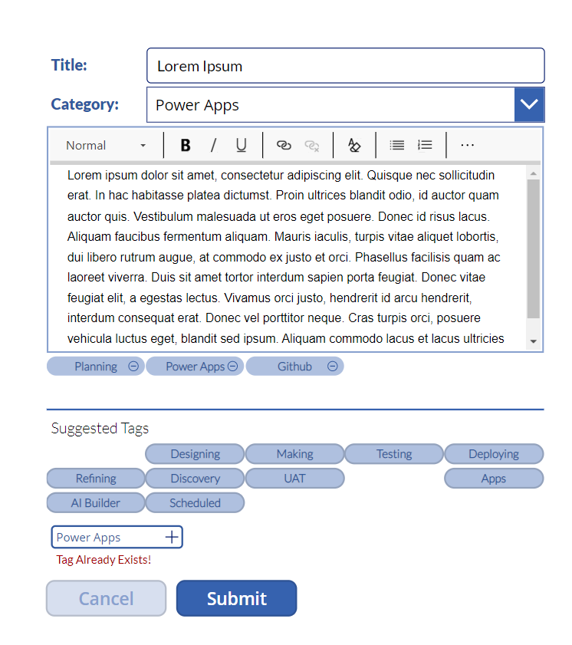
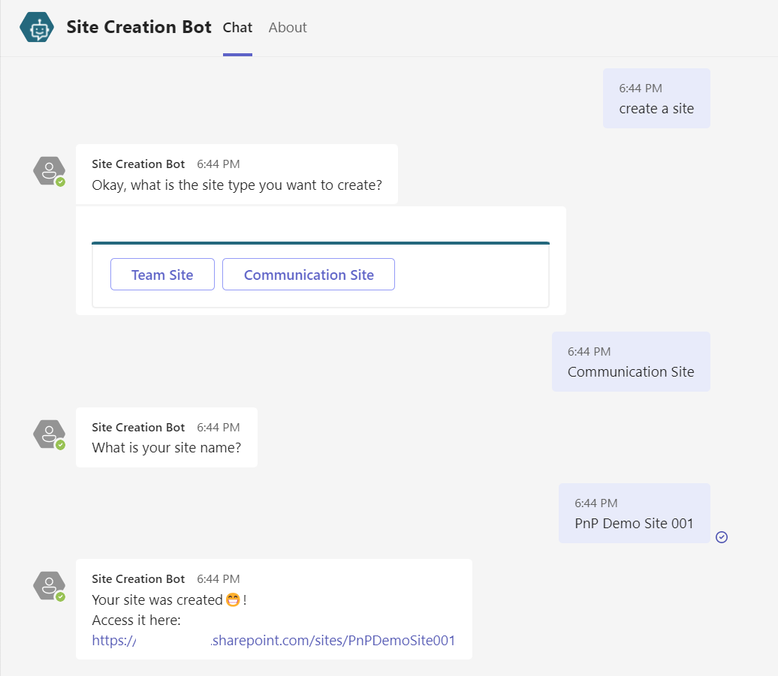




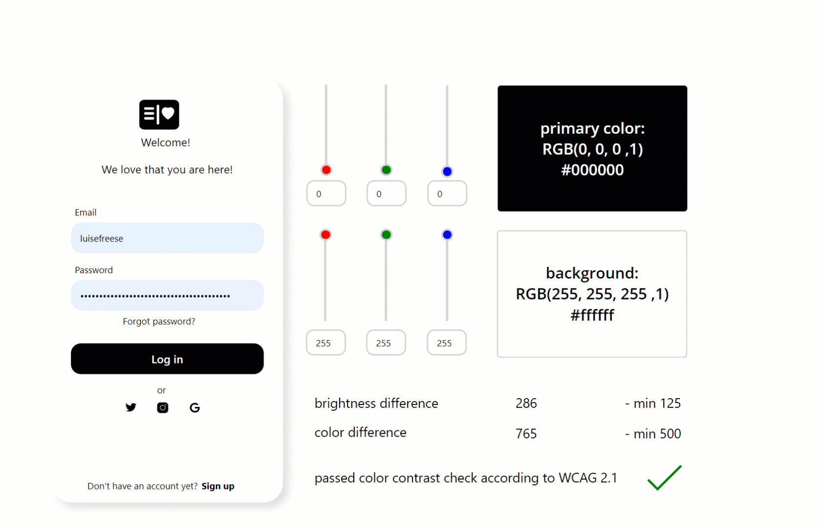
Power Platform Samples
New:
Keyword Tagger Matt Schuessler | @MattSchues
SharePoint Site Creation Bot Michel Mendes | @michelcarlo
Updates:
Accessibility color checker Luise Freese | @LuiseFreese
aka.ms/powerplatform-samples ​
Notes:
These are the updates that we processed since out last call.
New samples:
- Power Automate: SharePoint Collect Feedback April Dunnam | @aprildunnam Demonstrates:
Executing a Flow from a SharePoint Library with input parameters
Leveraging the custom responses option in Power Automate approvals
https://github.com/pnp/powerautomate-samples/tree/main/samples/sharepoint-collect-feedback
- Power Automate: Get Graph API Data within Power BI Reports Scott McKenzie | @365EDUBI Enables Graph API data to be refreshed within the Power BI Service. https://github.com/pnp/powerautomate-samples/tree/main/samples/graph_api_in_power_bi
Updated samples:
Power App: Fluent UI Custom Theme Fabio Franzini | @franzinifabio Fixed datepicker control theme https://github.com/pnp/powerapps-samples/tree/main/samples/fluentui-custom-theme
These latest samples should show within 24 hours

Slide 14
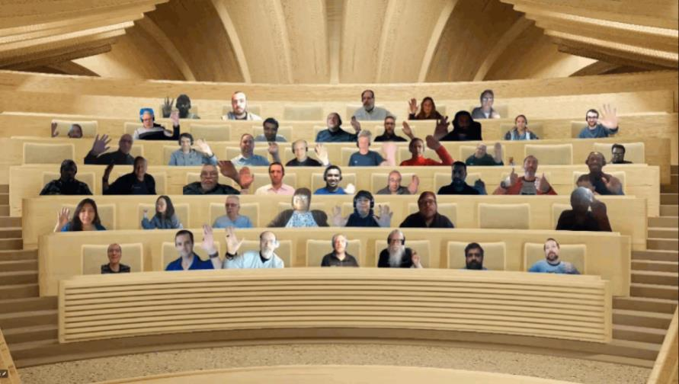

Optional picture time!
Video on and we’ll grab a Together Mode pic with those who are willing to do this.
We are together on this as a community!
By enabling your camera for the picture, you’ll give us the permission to share your picture in social media.

Slide 15
DEMO
Document automation with Syntex Content Assembly – Ankit Rastogi
Building an app for Microsoft Teams which creates conversational tabs and conversations based on external events – Eoin O'Brien
List Formatting – Warrior horses are here again! – Chris Kent

Slide 16
Thank you
Recording will be available in 24 hours on
Microsoft 365 Community (PnP) YouTube channel
https://aka.ms/m365/videos
(subscribe today)
Follow us on Twitter
@Microsoft365Dev | @M365PnP
Next M365 General Dev call: August 4th at 07:00am PT
Next Viva Connections & SharePoint Framework call: July 28th at 07:00am PT
See all other community calls from https://aka.ms/m365/calls

Slide 17



Slide 18
Thank you

